Slide 1
Name:- Yash Rajendra Gaikwad
Data Analytics Trainee
Project-8. ABC Call Volume Trend Analysis.
Software Used:- Microsoft Excel.
Analysis done on following Points:-
1) Average Call Analysis:- Determine the average duration of all incoming calls received by agents. this should be calculated for each Time bucket.
Task:- What is the average duration of calls for each time bucket?
2) Call Volume Analysis:-Visualize the total number of calls received. This should be represented as a graph or chart showing the number of calls against time. time should be represented in bucket(e.g., 1-2,2-3..etc)
Task:- Can you create a chart or graph thet showes the number of calls received in each time bucket?
3) Manpower Planning:- The current rate of abandoned calls is approximately 30%. Propose a plan for man power allocation during each time bucket (from 9am to 9pm) to reduce the abandonrate to 10%. in otherwords, you need to calculate the minimum number of agents require in each time bucket to ensure thet at least 90 out of 100 call are answered.
Task:- What is the minimum number of agents require in each time bucket to reduce the abandon rate to 10%?

Slide 2
4) Night Shift Manpower Planning:- Customers also call ABC insurance company at night but dont get an answer because there are no agents available. this creates a poor customer experience. Assumethat for every 100 calls that between 9am-9pm. the distribution of these 30 calls is as follows:
Task:- Propose a manpower plan for each time bucket throughout the day, keeping the maximun abandon rate at 10%.
Assumptions:- An agent works for 6 days a week; On average, each agent takes 4 unplanned leaves per month; An agent’s total working hour are 9 hours, out of which 1.5 hours are spent on lunch and snacks in the office. On average, an agent spends 60% of their total actual working hours(i.e., 60% of 7.5 hours) on calls with customer of days in monthis 30.
MICROSOFT EXCEL FILE:- https://docs.google.com/spreadsheets/d/1lIV2RpotYTDQZ8C1NH14jS7FvpLWJ08m/edit?usp=drive_link&ouid=103974361659264463652&rtpof=true&sd=true
VIDEO LINK:- https://www.loom.com/share/792c1e6f88bf498787e8b15f3499eaae?sid=d3880972-6d14-4cbc-a57b-298c54aa8fd4

Slide 3
1) Average Call Analysis:- Determine the average duration of all incoming calls received by agents. this shood be calculated for each Time bucket.
Task:- What is the average duration of calls for each time bucket?
Process:-
First we use the Pivot table for this task placing the time bucket in rows, Call stasus in columns and Call sec. in values
We use Average for call sec. from the value field setting.
After that, we use the slicer of Call status. we only select the answered from call stasus.
Then we use the column chart for Time bucket and average call status.
Result:-
The Average duration of calls for each time bucket is 198.6 i.e. 199 sec.
From chart we can say that, time bucket 19-20 i.e. 7pm-8pm had the highest average call answered in seconds.(203.4).

Slide 4
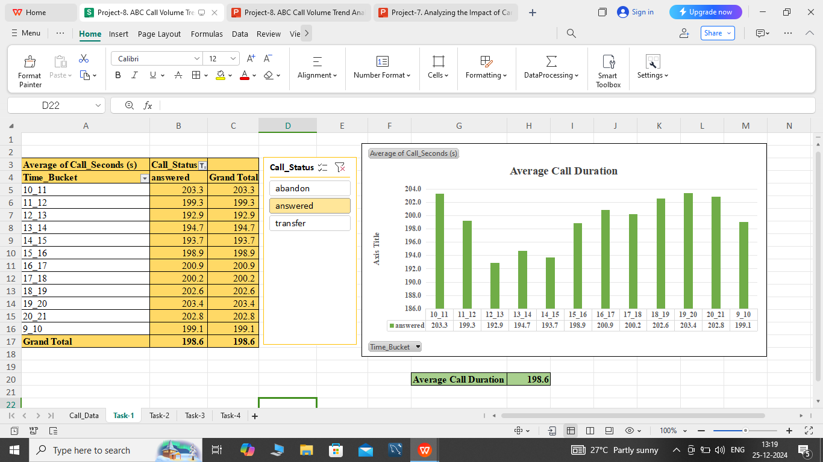

Slide 5
2) Call Volume Analysis:-Visualize the total number of calls received. This should be represented as a graph or chart showing the number of calls against time. time should be represented in bucket(e.g., 1-2,2-3..etc)
Task:- Can you create a chart or graph thet showes the number of calls received in each time bucket?
Process:-
First we use the Pivot table for this task placing the time bucket in rows, Call stasus in filter and Call sec. in values
We use Count for call sec. from the value field setting.
After that, we use the slicer of Call status. we only select the answered and transfer from call stasus to get the total calls received.
Then we use the column chart for Time bucket and Count of call status.
Result:-
The total count of calls received is 83585
From the we can say that, In time bucket 12-13 i.e. 12pm-1pm the highest count of calls received.(9579)

Slide 6
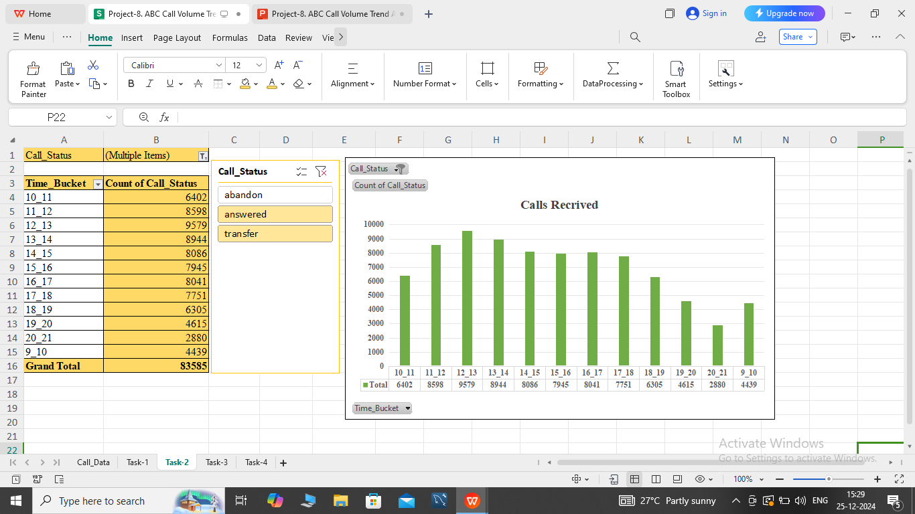

Slide 7



3) Manpower Planning:- The current rate of abandoned calls is approximately 30%. Propose a plan for man power allocation during each time bucket (from 9am to 9pm) to reduce the abandonrate to 10%. in otherwords, you need to calculate the minimum number of agents require in each time bucket to ensure thet at least 90 out of 100 call are answered.
Task:- What is the minimum number of agents require in each time bucket to reduce the abandon rate to 10%?
Process:-
First we use the Pivot chart placing call status in rows and count of customer phone number in values.
Then we also calculate the percentage by dividing the value by total and then convert it into percentage.
We get the total incoming calls and abandon calls by pivot table. then for no. of calls received we use sum function.
Working hours, Average call handeling and Occuoancy on average is allready given.
For calculating call handeling we use this formula
For minimun agents required we use
For Head count required,
Lastly for calculating Man power in each time bucket we devide the heat count required by 12.
$$\frac{(working time of agent in seconds)(occupancy)}{(Average Call Handling Time))}$$
$$\frac{Total Incoming Calls}{ Call Handling Capacity}$$
$$\frac{Minimum Agents Required}{1−Shrinkage Percentage}$$

Slide 8
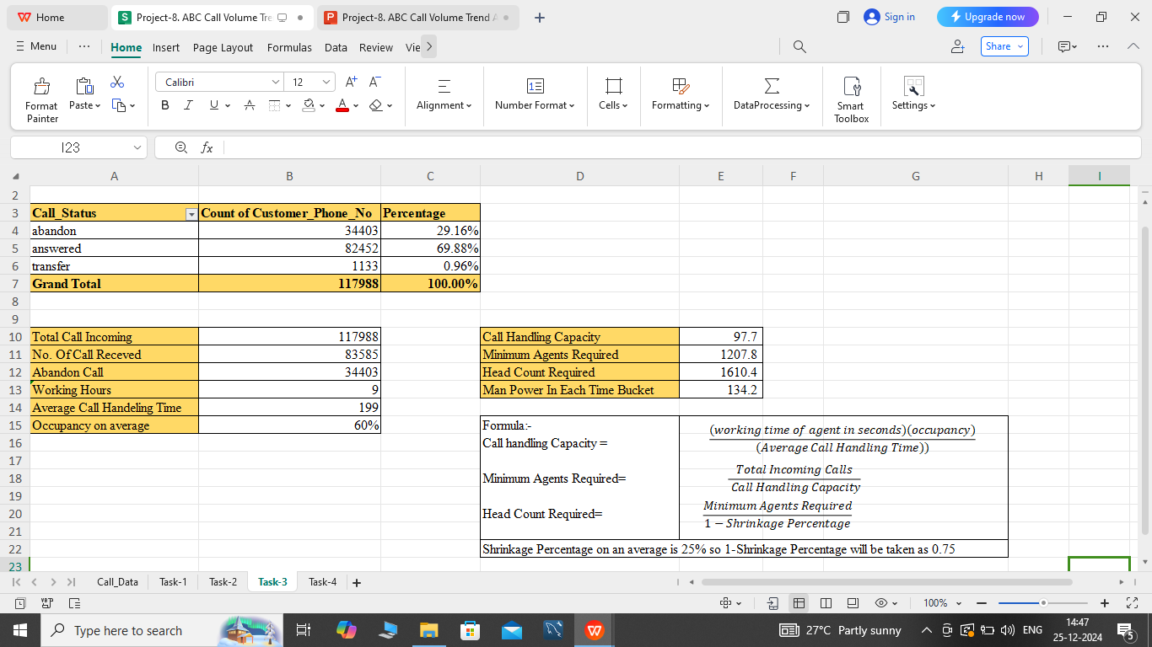

Slide 9
4) Night Shift Manpower Planning:- Customers also call ABC insurance company at nightbut dont get an answer because there are no agents available. this creates a poor customer experience. Assumethat for every 100 calls that between 9am-9pm. the distribution of these 30 calls is as follows:
Task:- Propose a manpower plan for each time bucket throughout the day, keeping the maximun abandon rate at 10%.
Assumptions:- An agent works for 6 days a week; On average, each agent takes 4 unplanned leaves per month; An agent’s total working hour are 9 hours, out of which 1.5 hours are spent on lunch and snacks in the office. On average, an agent spends 60% of their total actual working hours(i.e., 60% of 7.5 hours) on calls with customer of days in monthis 30.
Process:-
In this task use the same formulas in previous task .
First we cal calculate the no. of calls and then the no. of Agents require for this job.
Please refer the Excel sheet for detailed calculation.

Slide 10
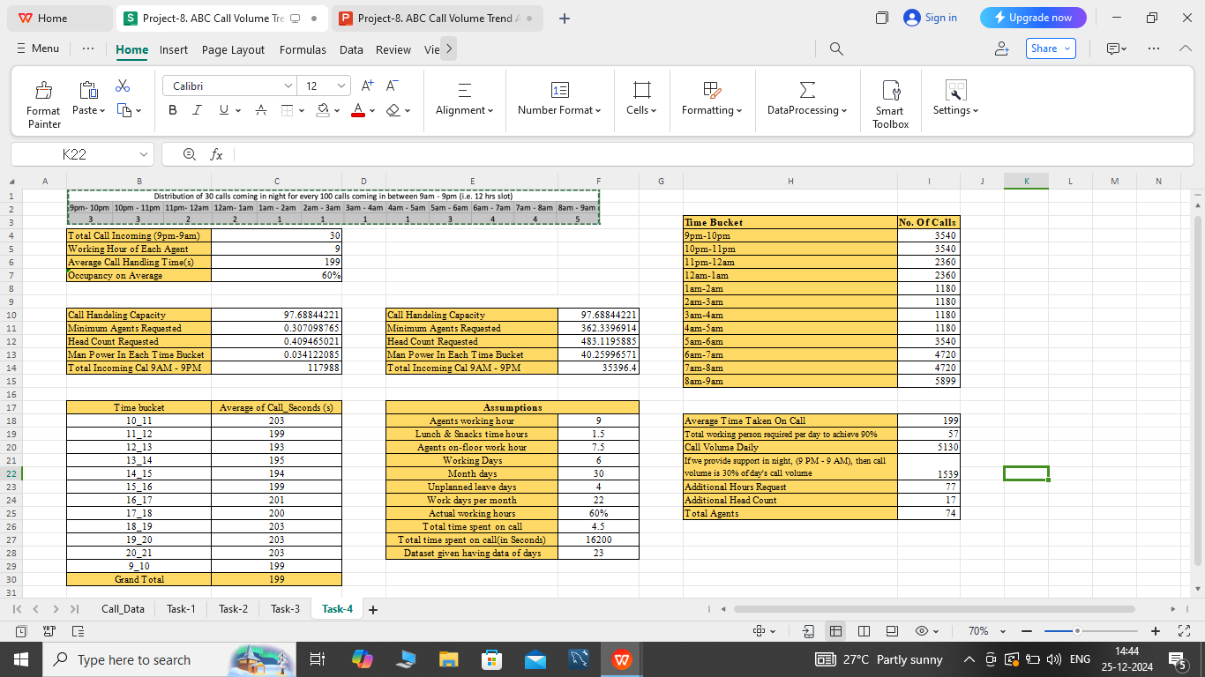

Slide 11
END
MICROSOFT EXCEL FILE:- https://docs.google.com/spreadsheets/d/1lIV2RpotYTDQZ8C1NH14jS7FvpLWJ08m/edit?usp=drive_link&ouid=103974361659264463652&rtpof=true&sd=true
VIDEO LINK:- https://www.loom.com/share/792c1e6f88bf498787e8b15f3499eaae?sid=d3880972-6d14-4cbc-a57b-298c54aa8fd4

